Slide 1
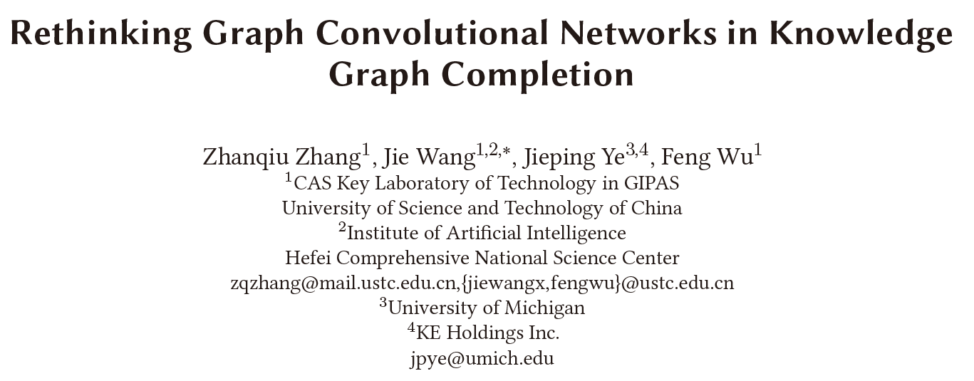
Haobo Xu
2022/10/26

Slide 2
Outlines
Background
KGC
GCN-based KGC
Rethinking
Do GCNs work in KGC?
Which factor works?
Framework & Experiments
Conclusion
Discussion
Zhang, Z., Wang, J., Ye, J., & Wu, F. Rethinking Graph Convolutional Networks in Knowledge Graph Completion. WWW 2022.

Slide 3
Background
Background
Rethinking
Framework & Experiments
Conclusion
Discussion
Knowledge Graph Completion
Methods
KGE
GNN for KG
PLM
…
Subtasks
Link prediction, relation prediction, triple classification

Slide 4
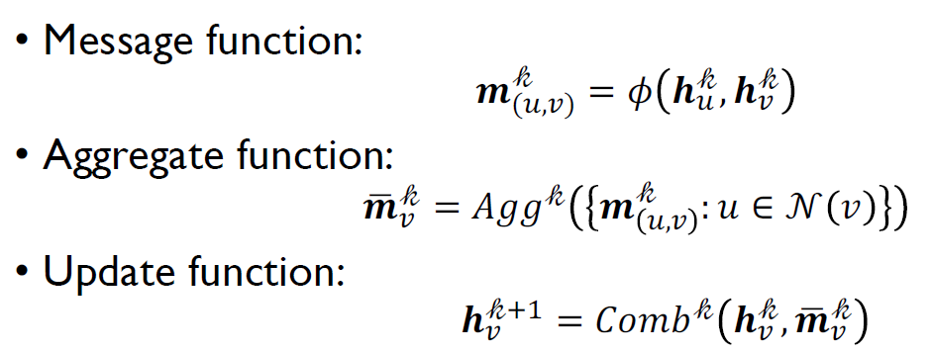
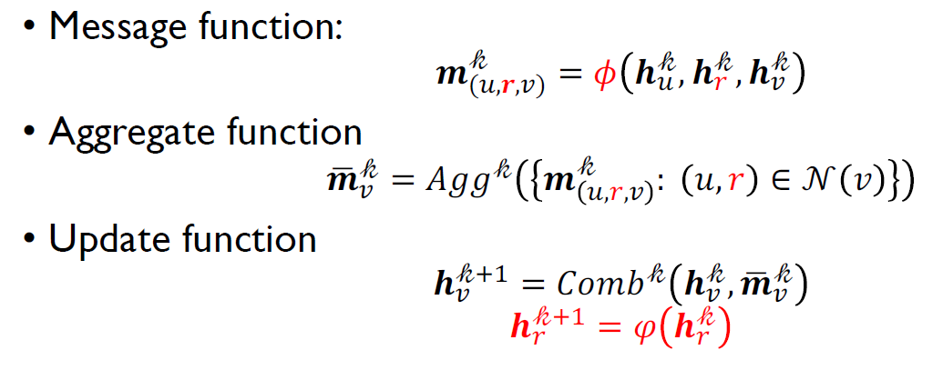
Background
Background
Rethinking
Framework & Experiments
Conclusion
Discussion
Motivation for GCN-based KGC methods
Inspired by GNN message passing
Aggregate neighbor & relation information for KGC

Slide 5
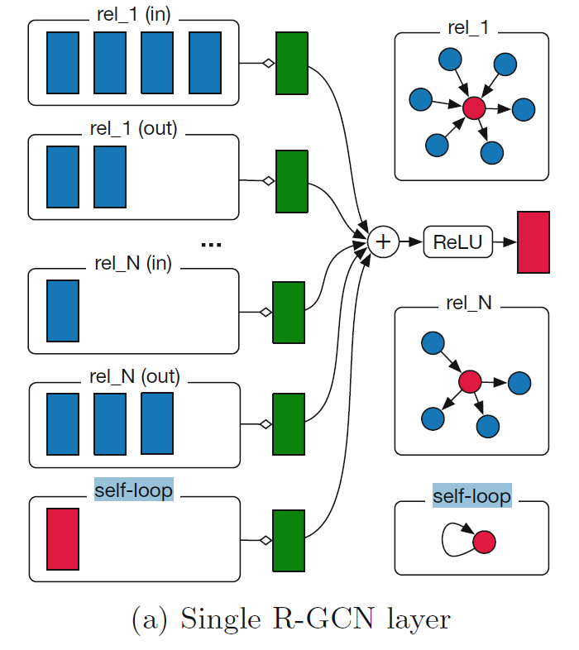

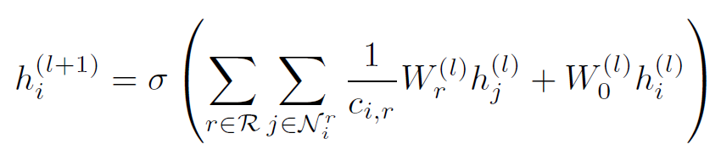
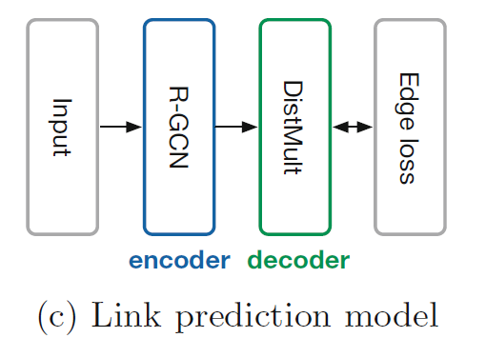
Background
Background
Rethinking
Framework & Experiments
Conclusion
Discussion
RGCN
Message function
Aggregate & Update function
Including inverse edges and self loop
Subtask: link prediction
R-GCN: encoder
KGE model: decoder
R-GCN: Modeling Relational Data with Graph Convolutional Networks. ESWC 2018.

Slide 6
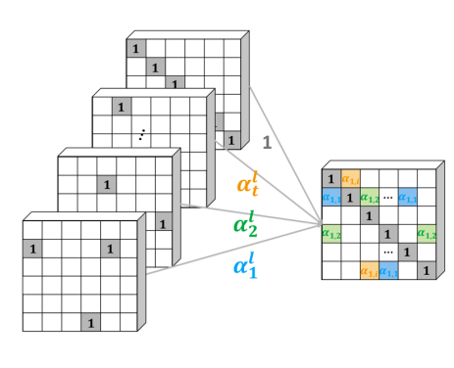

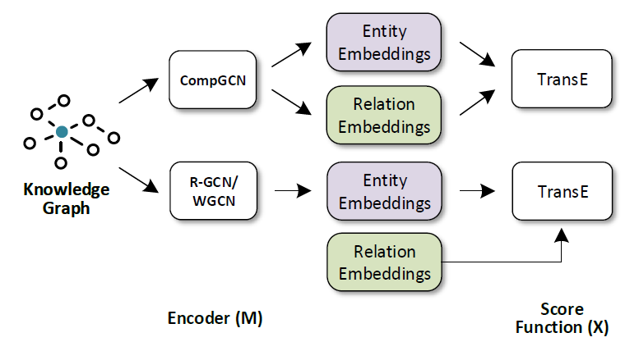
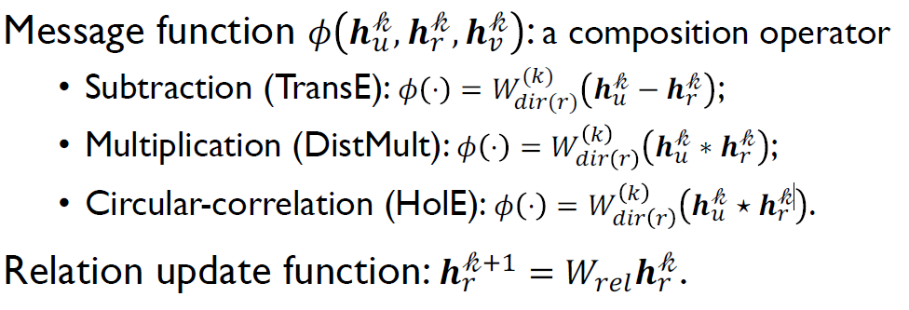
Background
Background
Rethinking
Framework & Experiments
Conclusion
Discussion
WGCN
Motivation:
RGCN over-parameterization for relation representation
Methods:
Multi-relational Graph
à weighted multiple single-relational subgraphs
CompGCN
Methods:
WGCN: End-to-end Structure-Aware Convolutional Networks for Knowledge Base Completion. AAAI 2019.
CompGCN: Composition-based Multi-Relational Graph Convolutional Networks. ICLR 2020.

Slide 7
Rethinking
Background
Rethinking
Framework & Experiments
Conclusion
Discussion
Overview
Q1: Do GCNs Really Bring Performance Gain?
Conclusion: GCNs do bring performance gain.
Q2: Which Factor of GCNs is Critical in KGC?
Conclusion:
GCNs based methods have three main parts
1) graph structures -> not necessary
2) transformations for relation -> not necessary
3) aggregated entity representation -> necessary
Have the same effect.
Can substitute for each other.
Neighborhood Information
Self-loop Information

Slide 8
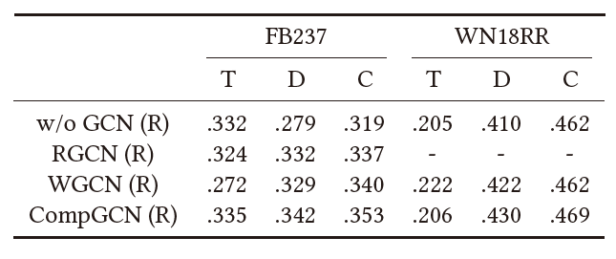
Rethinking
Background
Rethinking
Framework & Experiments
Conclusion
Discussion
Q1: Do GCNs Really Bring Performance Gain?
Fact
GCNs utilize training strategies, while original KGE models not, which may be unfair
Experiment
O: original papers, R: reproduce; T: TransE, D: DistMult, C: ConvE
Conclusion: GCNs do bring performance gain.

Slide 9
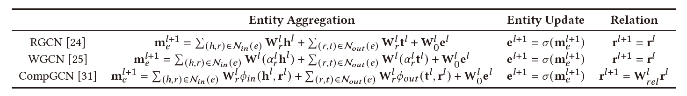
Rethinking
Background
Rethinking
Framework & Experiments
Conclusion
Discussion
Q2: Which Factor of GCNs is Critical in KGC?
Consensus: Main advantage of GCNs is ability to model graph structure
Review of GCNs for KGC
Graph Structure? Self-loop Information?
Neighborhood Information? Relations Update?

Slide 10
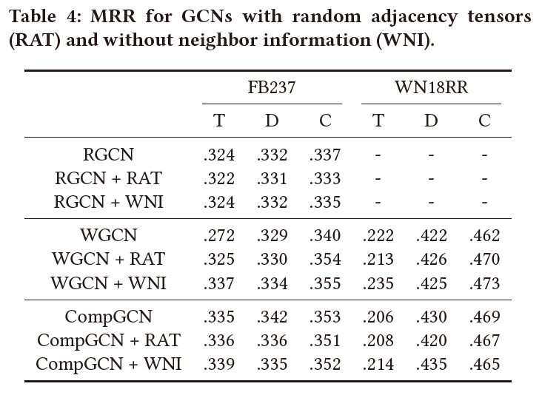
Rethinking
Background
Rethinking
Framework & Experiments
Conclusion
Discussion
Graph Structure Ablation Experiment
Break graph structure
Use the random adjacency tensors in message passing
Neighbor Information Ablation Experiment
Remove neighbor information term in aggregation function
Conclusion: Neither graph structure nor neighbor information is critical.

Slide 11
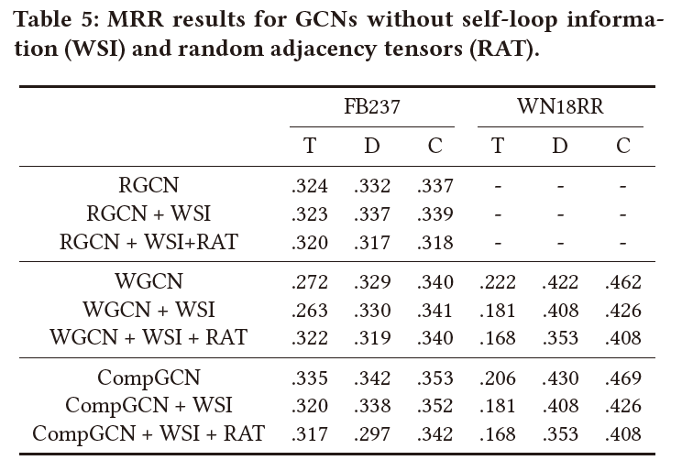
Rethinking
Background
Rethinking
Framework & Experiments
Conclusion
Discussion
Self Loop Ablation Experiment
Remove self loop term in aggregation function
Result: (X+WSI) Keeping only neighbor information achieves comparative results
Self Loop + Random Neighbors Experiment
Result: (X+WSI+RAT) Only aggregating randomly generated neighbor information achieve comparative results
Conclusion: Self Loop Information is not critical.
Conclusion: Keeping only randomly selected neighbor information still works.

Slide 12
Rethinking
Background
Rethinking
Framework & Experiments
Conclusion
Discussion
Guesswork: The followings contain semantical information, which can distinguish entities from others
1) self-loop
Reason: The representation of each entity is independent.
2) neighbor information
Reason: Entities with different neighbors have different semantics.
3) randomly generated neighbor
Reason: Assign different neighbors for different entities with a high possibility, thus different entities have different sets of neighbors (just like a hash number).
Any of the above (that can distinguish entities) has the same effect on the final performance.

Slide 13
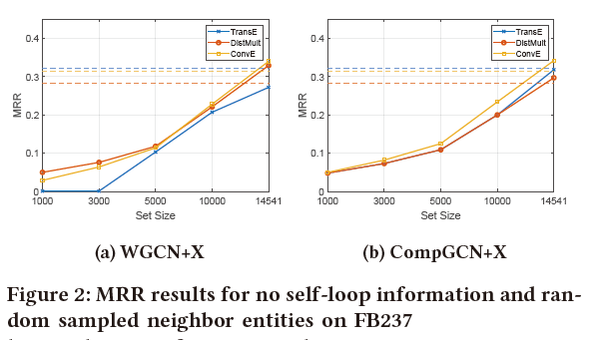
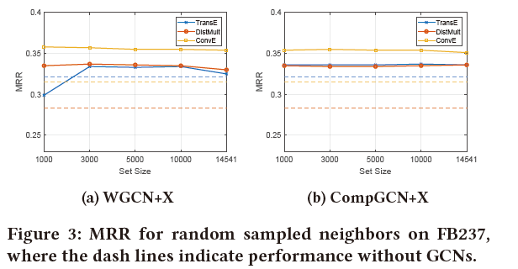
Rethinking
Background
Rethinking
Framework & Experiments
Conclusion
Discussion
Experiment:
Methods: Randomly sample neighbors in a given set.
Expectation: When set size becomes smaller, entities get harder to distinguish themselves from others, thus the performance get worse
Without self-loop + Random sampled neighbors
(agree with expectation)
With self-loop + Random sampled neighbors
(disagree with expectation)
Conclusion: Self-loop / neighbor Info both can distinguish entities to bring performance gain

Slide 14
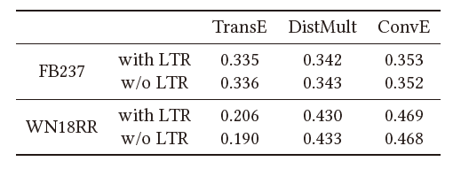

Rethinking
Background
Rethinking
Framework & Experiments
Conclusion
Discussion
Linear Transformations for Relations (CompGCN)
Conclusion: Linear transformation is not necessary

Slide 15
Rethinking
Background
Rethinking
Framework & Experiments
Conclusion
Discussion
Summary
GCNs based methods have three main parts
1) graph structures -> not necessary
2) transformations for relation -> not necessary
3) aggregated entity representation -> necessary
Neighborhood Information
Both of them can distinguish entity to bring performance gain
Self-loop Information

Slide 16







Framework & Experiments
Background
Rethinking
Framework & Experiments
Conclusion
Discussion
Linear Transformed Entity(LTE) – KGE Model
Framework
W_{h}, W_{t} can share the same parameters
g_{h}, g_{t} ∈ {Identity function, activation functions, batch normalization, dropout, …}
Compared to TransR
Memory-efficient and flexible to incorporate non-linear operations
Relationship with GCNs (g = Id): The gradient of loss function
LTE-TransE
LTE-DistMult
LTE-ConvE
Same as 1–Layer GCN aggregation function

Slide 17
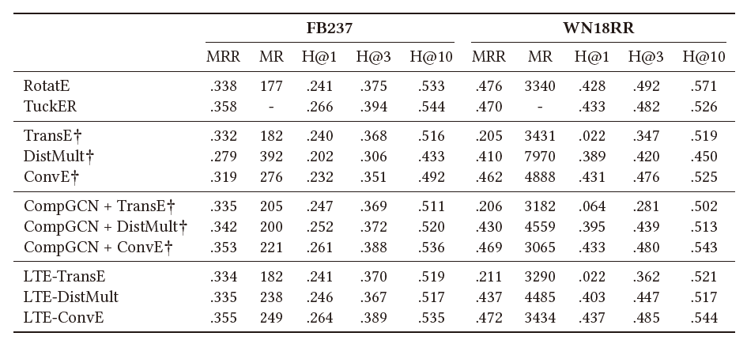
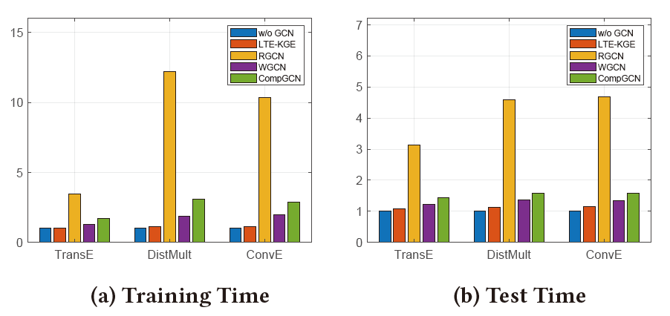
Background
Rethinking
Framework & Experiments
Conclusion
Discussion
Framework & Experiments
Linear Transformed Entity(LTE) – KGE Model
Experiments
1 – Layer
GCN

Slide 18
Conclusion
Background
Rethinking
Framework & Experiments
Conclusion
Discussion
The transformations for entity embeddings which can distinguish different entities account for the performance improvements for GCN-based methods.

Slide 19
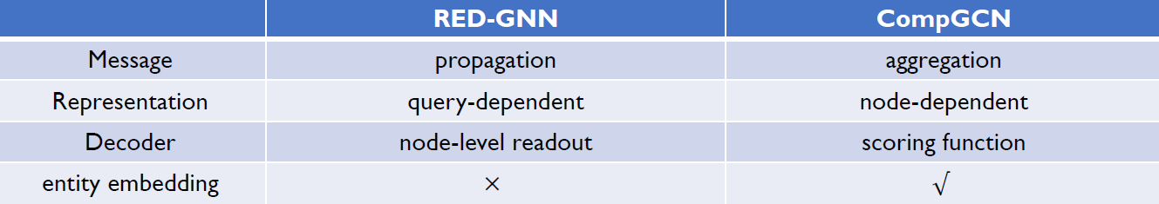
Discussion
Background
Rethinking
Framework & Experiments
Conclusion
Discussion
RGCN/WGCN/CompGCN slightly outperform KGE only by transformation of entity embeddings (not by aggregating neighbor information)
-> Maybe the entity transformation contains global information?
RED-GNN v.s. CompGCN
This article mainly focus on aggregation-like message passing model with entity embeddings, while RED-GNN propagate message without entity embeddings.
Path (not simply aggregating neighbor information) seems important to bring performance gain.

Slide 20
Thanks！

